Slide 1
B.Tech – CSE – Sem. 3 18CSS201J – ANALOG AND DIGITAL ELECTRONICS (Regulations 2018)
UNIT 4
Session-2 ( Gated SR Flip Flops, Edge Triggered RS Fip-flop)
Session-3(Edge Triggered D Fip-flops, Edge Triggered T Fip-flops)

Slide 2
Gated SR Latch

Slide 3
The basic latch changes its state when the input signals change
It is hard to control when these input signals will change and thus it is hard to know when the latch may change its state.
We want to have something like an Enable input
In this case it is called the “Clock” input because it is desirable for the state changes to be synchronized

Slide 4
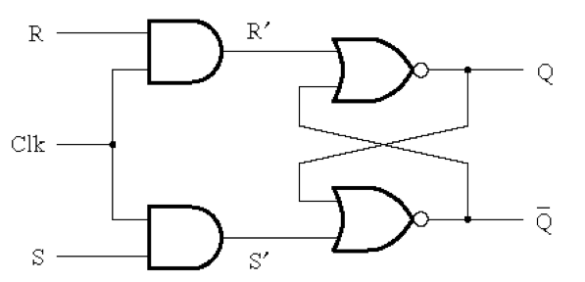
Circuit Diagram for the Gated SR Flip-Flop
[ Figure 5.5a from the textbook ]

Slide 5
Circuit Diagram for the Gated SR Flip-Flop
This is the “gate”
of the gated latch

Slide 6
Circuit Diagram for the Gated SR Flip-Flop
Notice that these are complements of each other

Slide 7
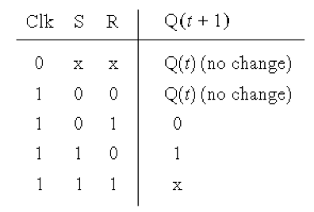
Circuit Diagram and Characteristic Table
for the Gated SR Flip-Flop
[ Figure 5.5a-b from the textbook ]

Slide 8
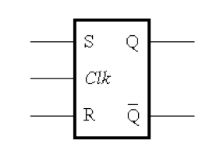
Circuit Diagram and Graphical Symbol
for the Gated SR Flip-Flop
[ Figure 5.5a,c from the textbook ]

Slide 9
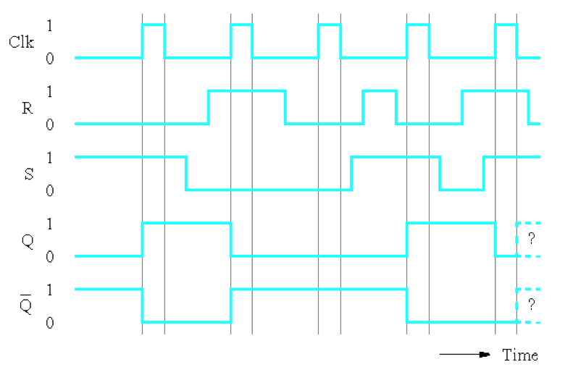
Timing Diagram for the Gated SR Flip-Flop
[ Figure 5.5c from the textbook ]

Slide 10
Gated SR Flip-Flop with NAND gates
S
Q
Clk
Q
R
[ Figure 5.6 from the textbook ]

Slide 11
Gated SR Flip-Flop with NAND gates
S
Q
Clk
Q
R
In this case the “gate” is constructed using NAND gates! Not AND gates.

Slide 12
Edge-Triggered Flip-Flops
In basic master-slave flip-flops, master is enabled during the entire period the control input is 1.
This can result in 0’s and 1’s catching.
To avoid this, signals on information lines are restricted from changing during the time the master is enabled.
Also a delay in the output since master’s state is established during the positive edge and transferred to the slave on the negative edge of clock.
Edge-triggered flip-flops use just one of the edges of the clock signal.
This is referred to as the triggering edge.
Response to triggering edge at the output of the flip-flop is almost immediate (depends only on propagation delay times).
Once triggering occurs, flip-flop is unresponsive to information input changes until the next triggering edge.

Slide 13
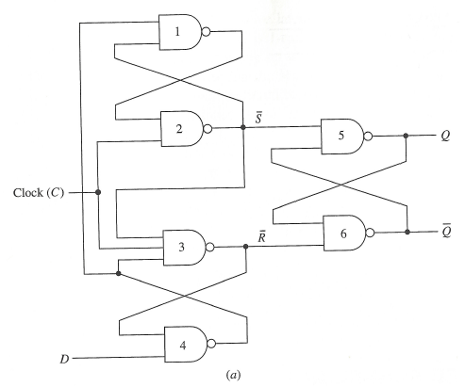
Edge-Triggered SR Flip-Flops
C = 0. Regardless of input at D, outputs of gates 2,3 are 1. So $\overline{S}=\overline{R}=1.$ State of latch is held.
Assume D = 0: Output of gate 4 is 1, output of gate 1 is 0. When C goes to 1: all inputs to gate 3 are 1, output changes to 0. Output of gate 2 remains at 1 since output of gate 1 is 0. So $\overline{S}=1,\overline{R}=0$. Output of gate 3 (0) is fed to input of gate 4. Output of gate 4, gate 1 not affected by changes to D.
Assume C = 0, D = 1. Outputs of gates 2,3, are 1. Output of gate 4 is 0, output of gate 1 is 1. When C goes to 1: output of gate 2 is 0, output of gate 3 remains at 1. So $\overline{S}=0,\overline{R}=1$. Output from gate 2 is input to gates 1, 3 so their outputs remain at 1. Changes in D have no affect on state of flip-flop while C = 1.
$\overline{S}\overline{R}$ Latch

Slide 14
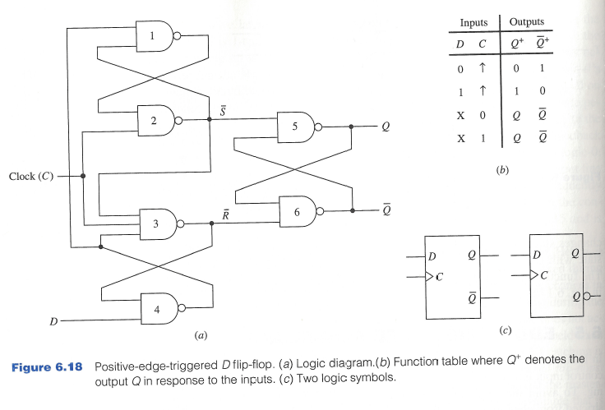
Edge-Triggered SR Flip-Flops

Slide 15
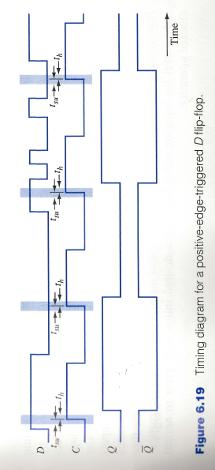
Timing Diagram
During setup and hold times $t_{su},t_{h}$ with respect to the triggering edge of the clock, D input must not change.

Slide 16
Negative-Edge Triggered D Flip-Flop
A falling edge (high to low transition) of control signal is used to sample the D input line.
Simply place inverter at the control input of the flip-flop.

Slide 17
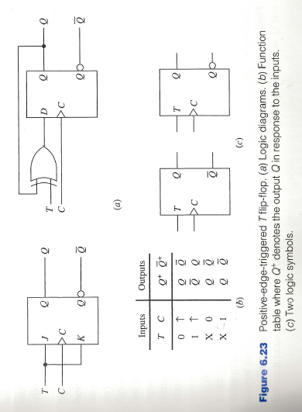
Positive-Edge Triggered T-Flip-Flop

Slide 18
Characteristic Equations
Next state table: Shows the value of the next state of the flip-flop for each combination of values to the present state of the flip-flops and their information lines.
The algebraic description of the next-state table of a flip-flop is called the characteristic equation of the flip-flop.
Obtained by constructing the K-map for $Q^{+}$ in terms of the present state and information input variables.

Slide 19
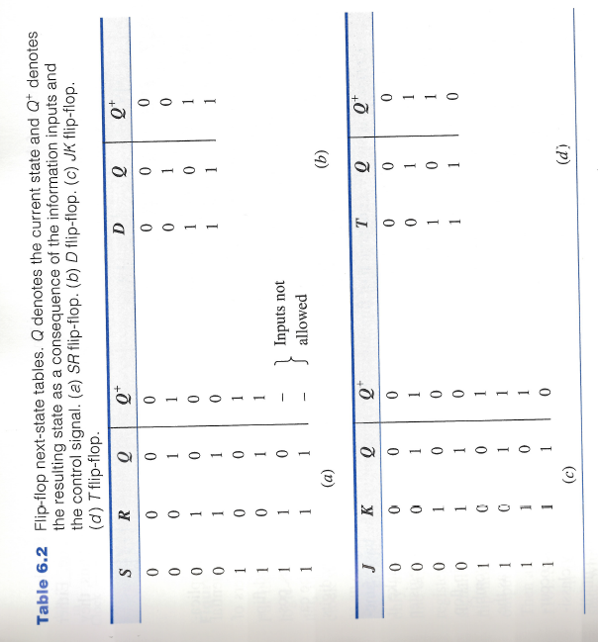
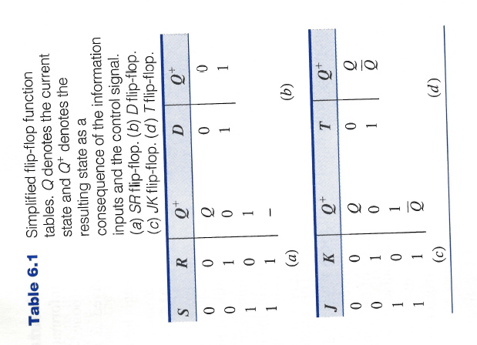
Next State Tables

Slide 20
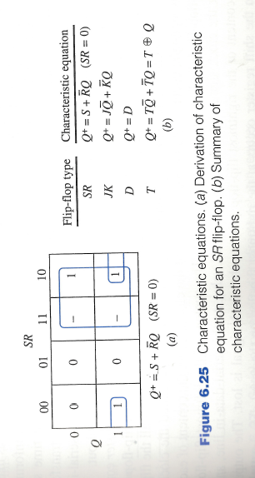
Characteristic Equations

Slide 21
T Flip Flop
This is a much simpler version of the J-K flip flop. Both the J and K inputs are connected together and thus are also called a single input J-K flip flop.
When clock pulse is given to the flip flop, the output begins to toggle. Here also the restriction on the pulse width can be eliminated with a masterslave or edge-triggered construction.

Slide 22
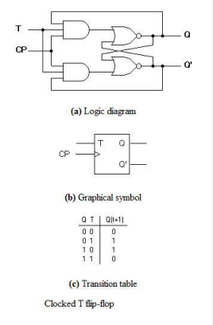

Slide 23
Flip-Flop Solution
Use edge-triggering instead of master-slave
An edge-triggered flip-flop ignores the pulse while it is at a constant level and triggers only during a transition of the clock signal
Edge-triggered flip-flops can be built directly at the electronic circuit level, or
A master-slave D flip-flop which also exhibits edge-triggered behavior can be used.

Slide 24
Edge-Triggered D Flip-Flop
D
D
Q
S
Q
Q
The edge-triggered D flip-flop is the same as the master- slave D flip-flop
It can be formed by:
Replacing the first clocked S-R latch with a clocked D latch or
Adding a D input and inverter to a master-slave S-R flip-flop
The delay of the S-R master-slave flip-flop can be avoided since the 1s-catching behavior is not present with D replacing S and R inputs
The change of the D flip-flop output is associated with the negative edge at the end of the pulse
It is called a negative-edge triggered flip-flop
C
C
C
Q
R
Q
Q

Slide 25
Positive-Edge Triggered D Flip-Flop
D
D
Q
S
Q
Q
C
C
C
Q
R
Q
Q
Formed by adding inverter to clock input
Q changes to the value on D applied at the positive clock edge within timing constraints to be specified
Our choice as the standard flip-flop for most sequential circuits

Slide 26
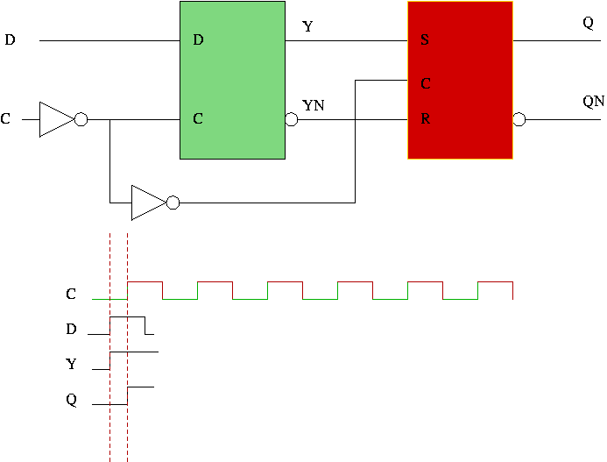
Edge-Triggered FF Operation

Slide 27
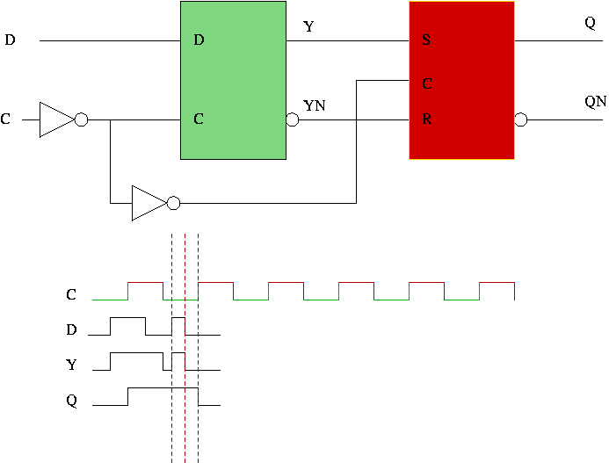
Edge-Triggered FF Operation

Slide 28

Edge-Triggered FF Operation

Slide 29
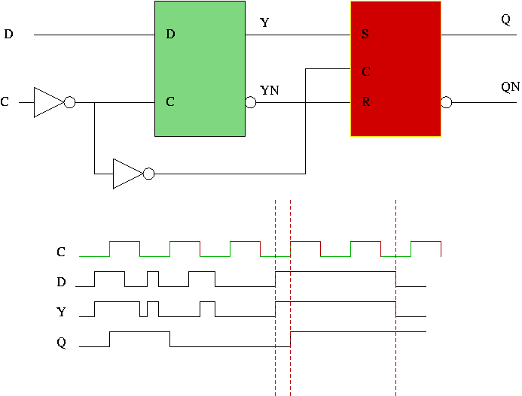
Edge-Triggered FF Operation

